Slide 1
Barna NS Active School Flag Renewal

Slide 2
Active School Committee 2016/2017

Slide 3
Brain Breaks in the Junior Room
We like to Move it!!

Slide 4
Brain Breaks in the Junior Room
We like to Move it!!

Slide 5
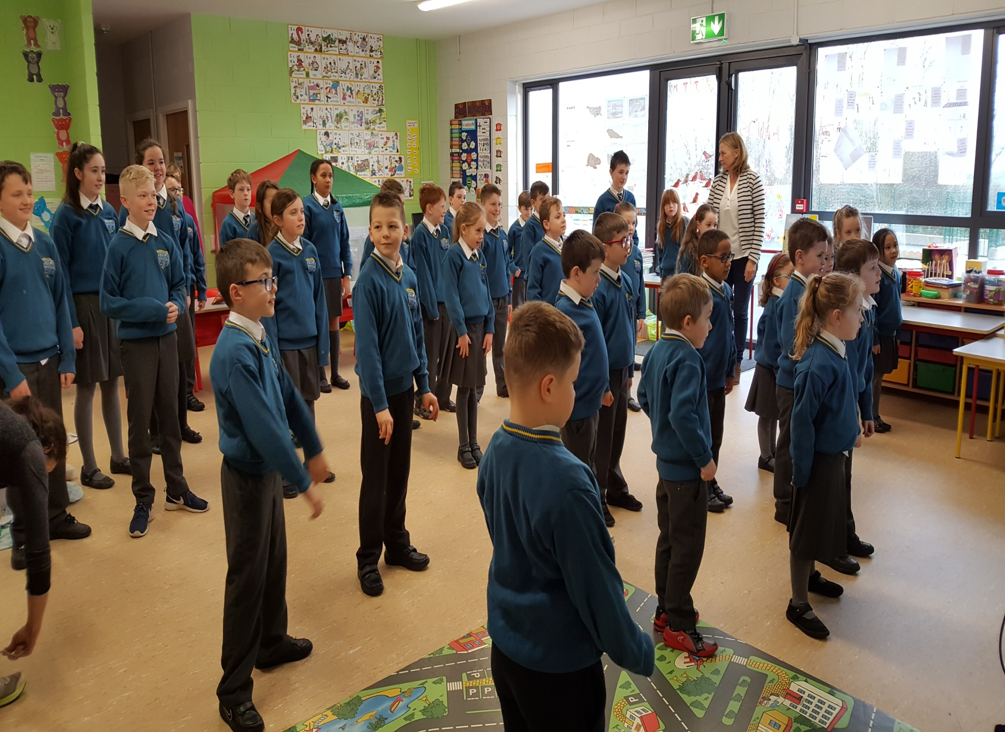
Operation Transformation 10@10

Slide 6
Operation Transformation - Karl Henry
Many pupils supported our local Operation Transformation leader by walking & jogging 5km each Monday, Wednesday and Thursday during January, February, March and April.

Slide 7
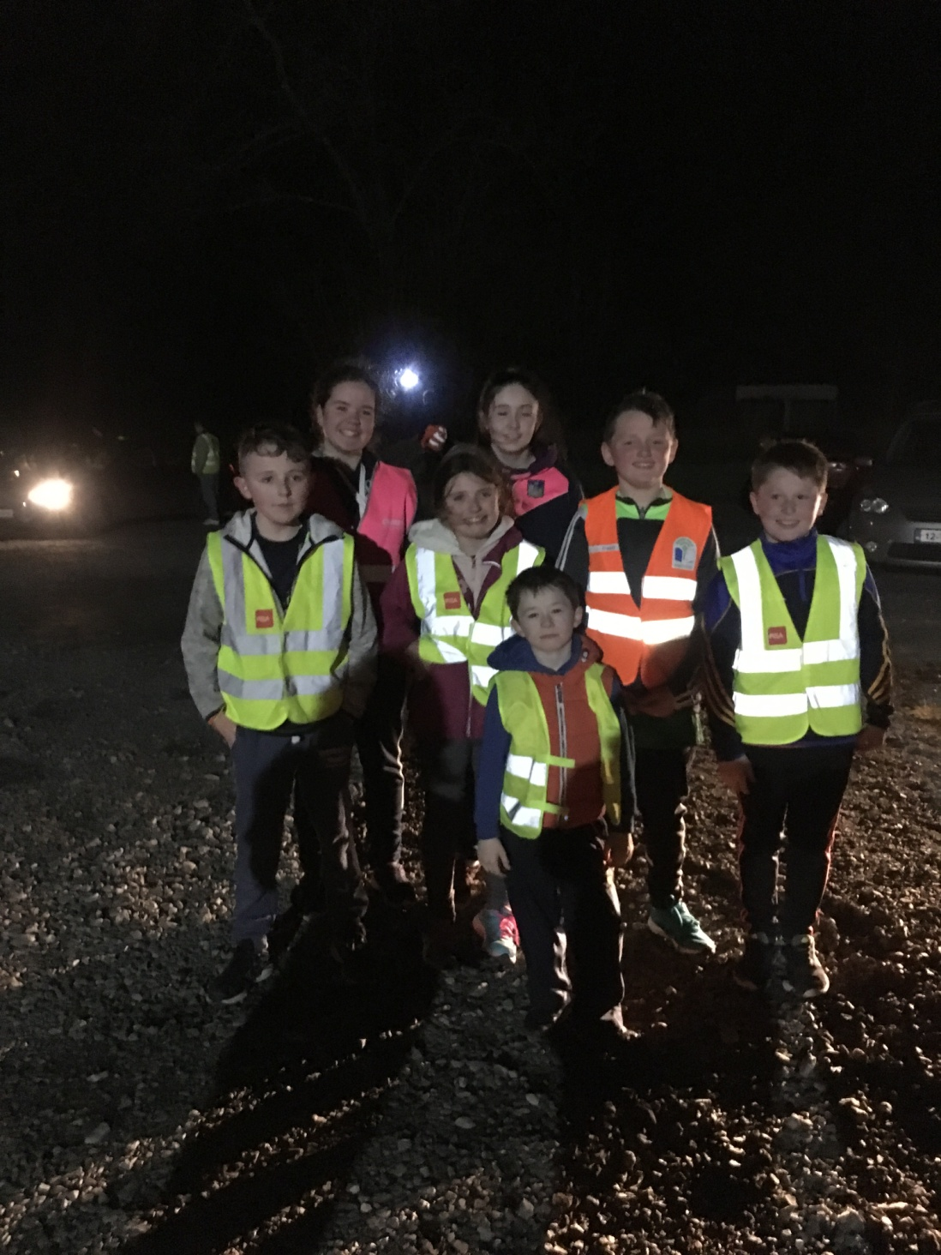
Operation Transformation Local 5km Walk/Jog with Group Leader

Slide 8
Running Initiative 2017
Thomand Park
to
Croke Park!! (221km)

Slide 9
Pupils launch Barna NS Running Initiative 2017

Slide 10
Running Initiative
DEAR – Drop Everything And Run!
Over a number of weeks, each class ran laps of the school yard which when added all together made 221km!

Slide 11
DEAR – Drop Everything And Run!!

Slide 12
Drop Everything and Run!!
Junior Room running their laps!!

Slide 13
Junior Room Running (DEAR)

Slide 14
Cool Down Stretches

Slide 15
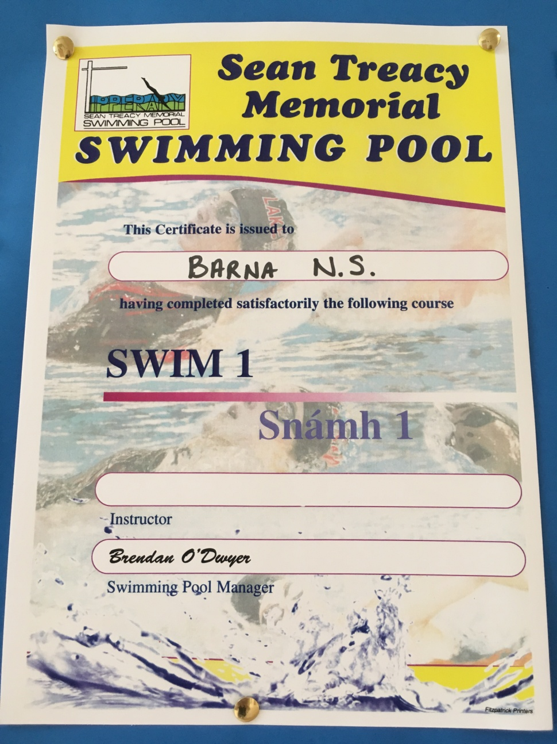
PE- Aquatic Strand (8 weeks Swimming lessons)

Slide 16
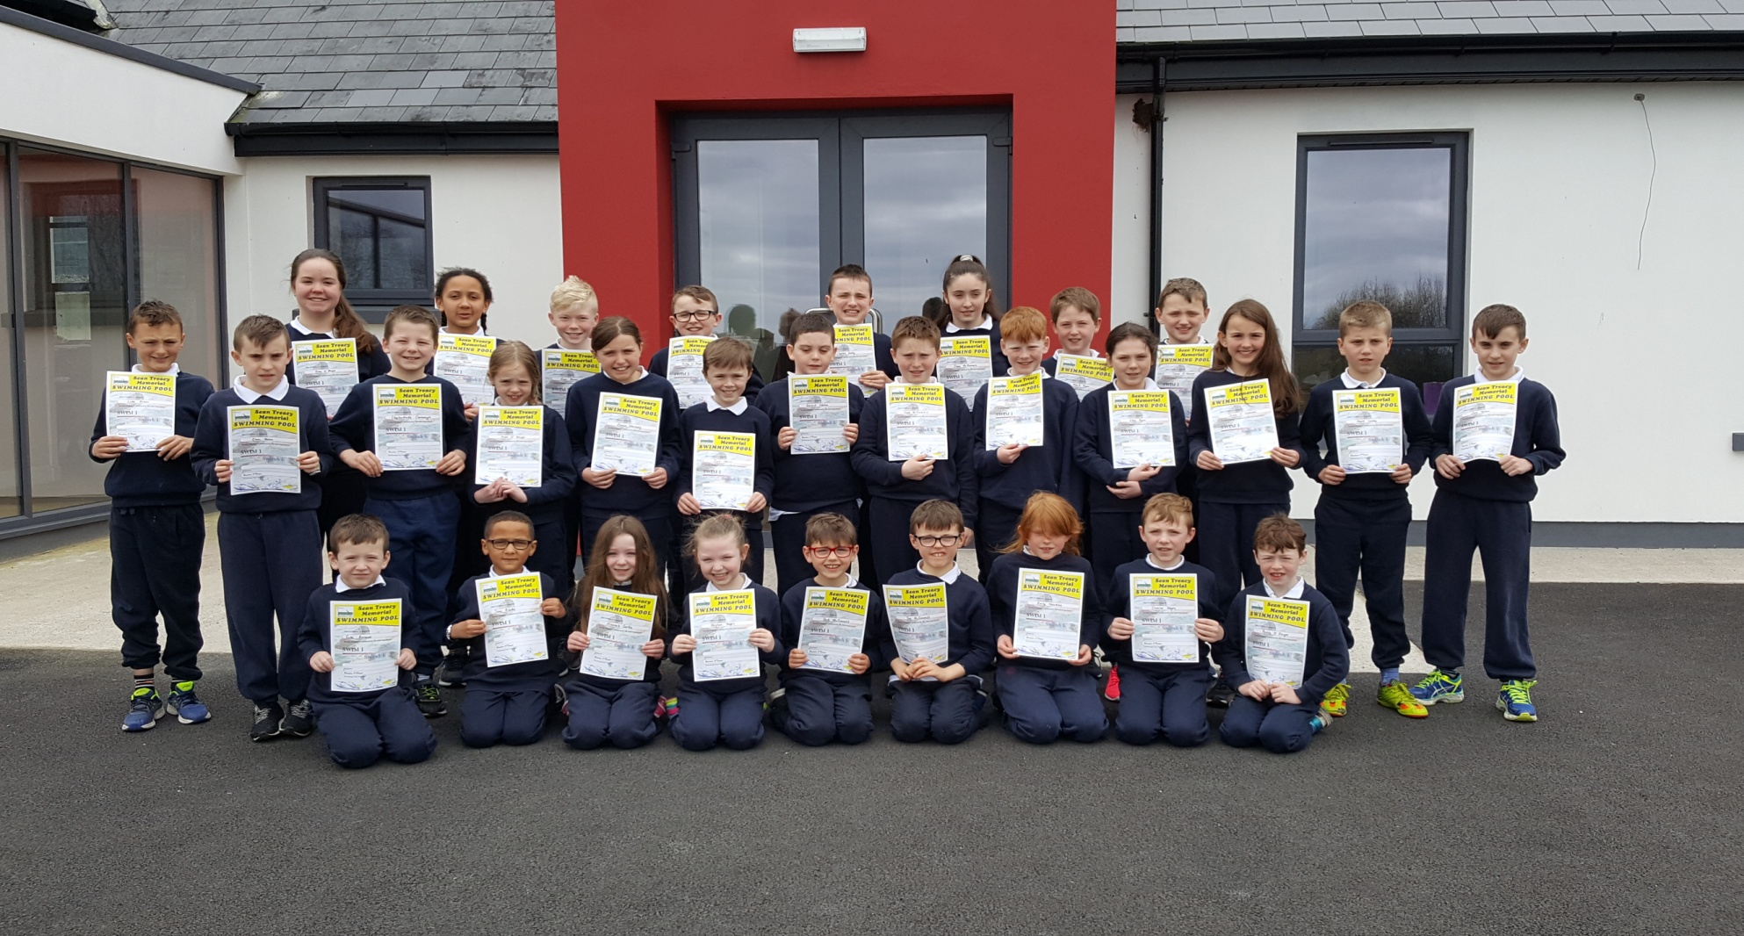
1st – 6th classes receive their Swim Certificates after their 8 week Swimming Lessons in Tipperary Swimming Pool February, March & April 2017

