Slide 1
Barna N.S
SFI Plaque of STEM
Log Of Evidence
2019

Slide 2
Barna National School 16439j

Slide 3
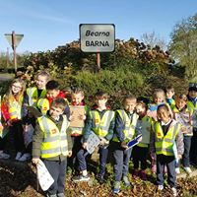
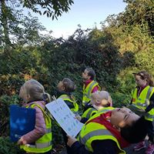
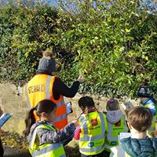
STEP 1- SCIENCE
LIVING THINGS- SIGNS OF SPRING

Slide 4
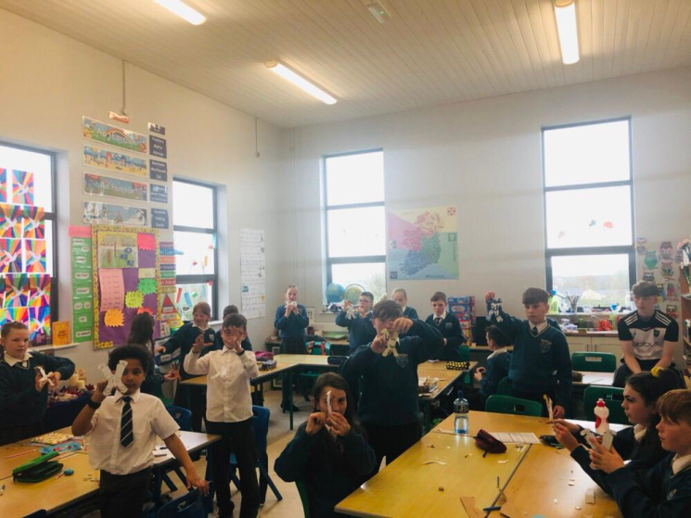
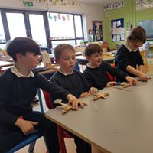
Energy and Forces
Acrobatic Clown
Catapults

Slide 5
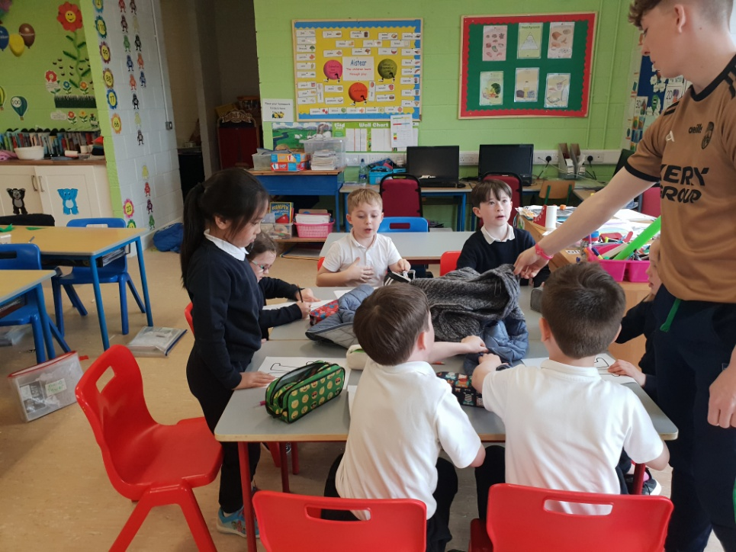
Materials
Our student Teacher Stephen, working on investigating materials with our first and second class pupils.

Slide 6
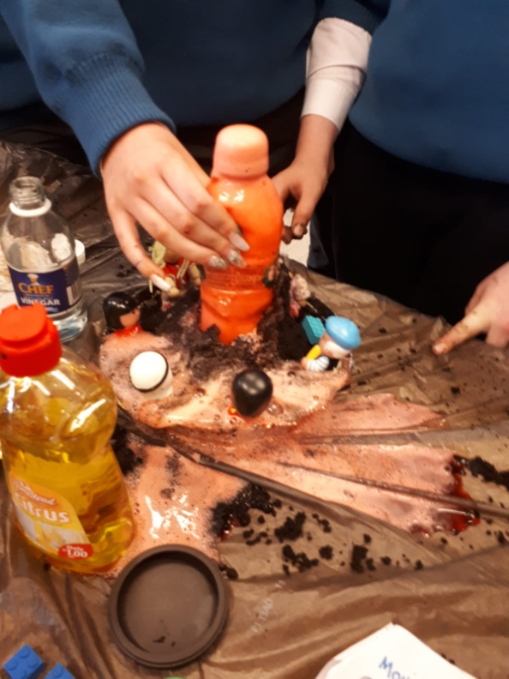
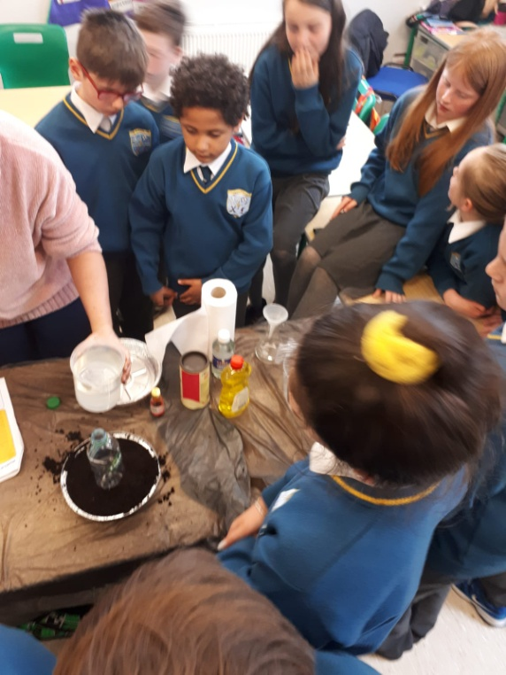
Environmental awareness and care
Our Senior pupils Making and Monitoring a Volcano

Slide 7
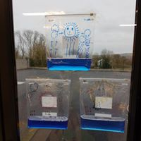
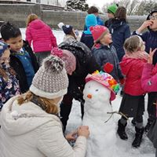
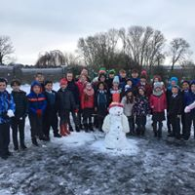
Environmental Awareness and Care
Some more experiments about our environment.
Learning about the water cycle
Building a snowman

Slide 8
Participate in a Science Event
Brainteaser Bandits @MIC

Slide 9
Science Speaker
Mr. Bernie O`Connell came to the school and chatted to the pupils about rural electrification in the Pallasgreen area.
He explained about life before electricity and how electricity helped to improve the lives of the local people including many of the pupils grandparents.

Slide 10
Science Event

Slide 11
Science Event
The Senior pupils in Barna completed some of their own projects on Rural electrification to be showcased at an event run in the High Nelly Cafe in Pallasgreen with local speaker Bernie O Connell.

Slide 12
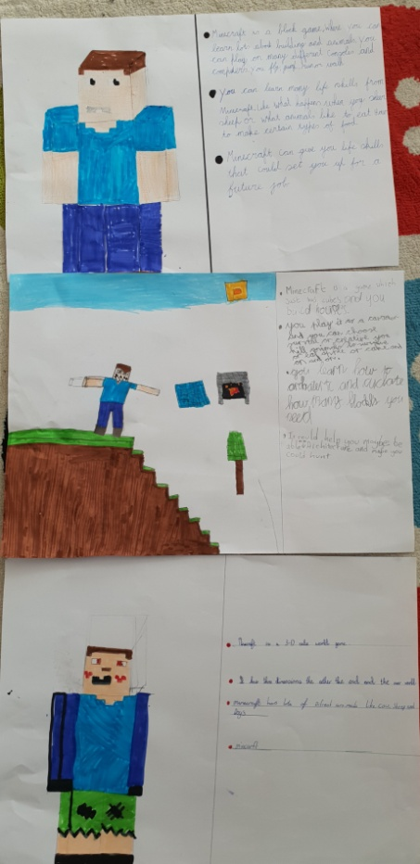
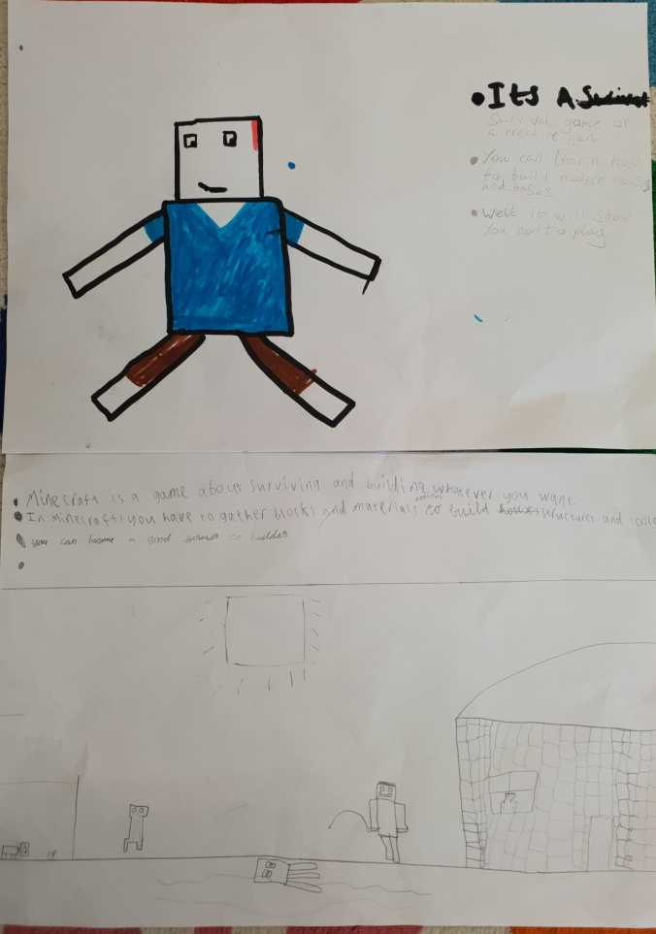
STEP 2- TECHNOLOGY
Discussing the use of Game based learning.

Slide 13
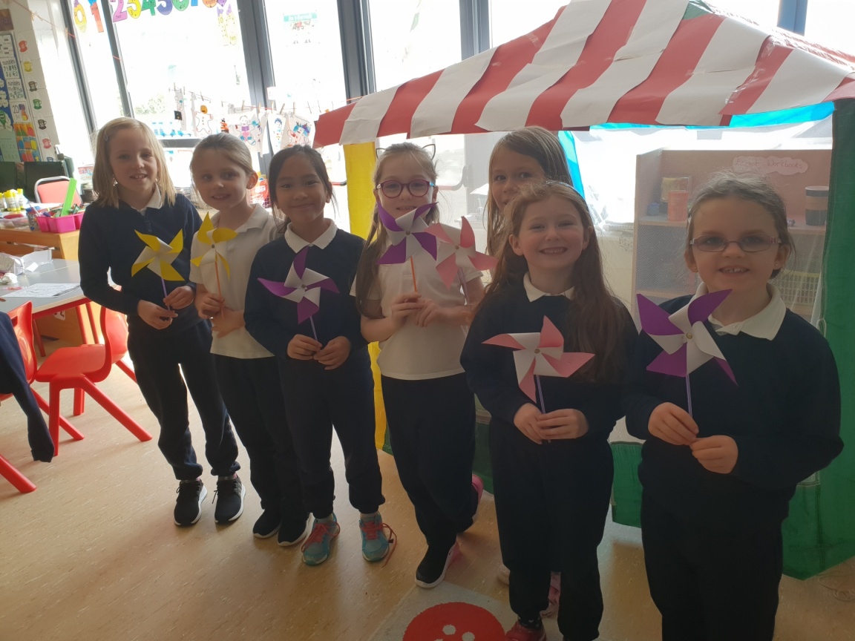
Exploring Renewable Energy Technologies
Building simple Windmills
Pupils in 1st and 2nd class learned all about renewable energy and why it is important to think carefully about using our energy resources and conserving our planet for the next generation.

Slide 14
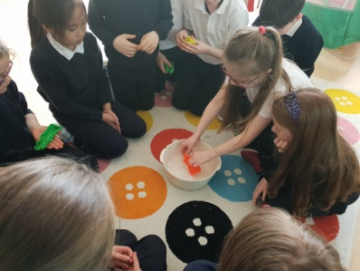
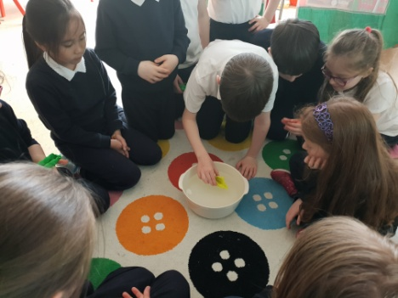
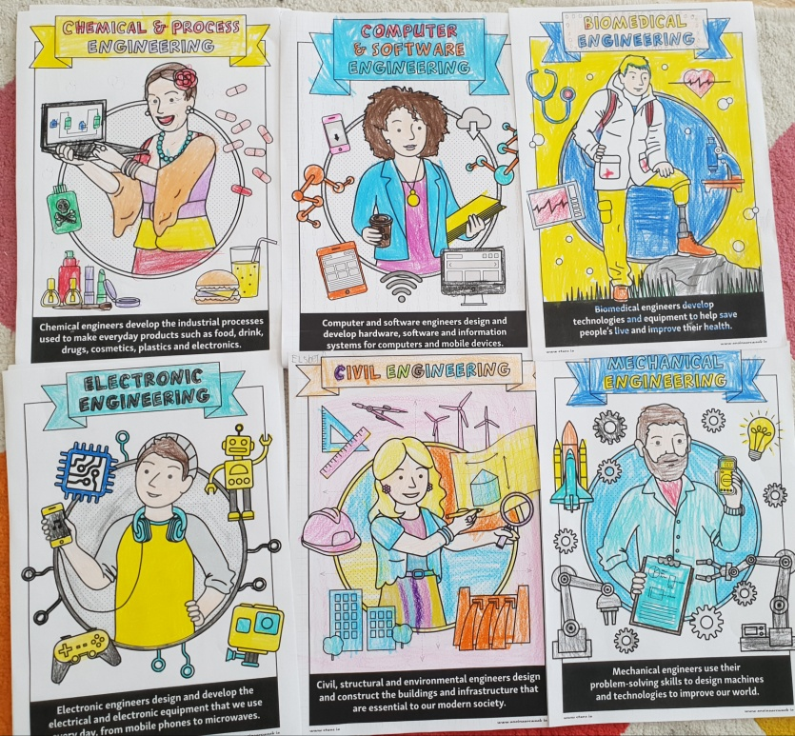
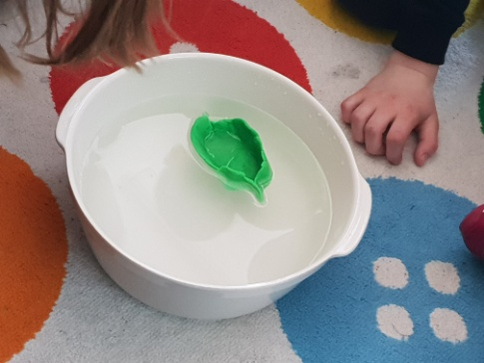
STEP 3 ENGINEERING
Designing a boat
Looking at Types of Engineers.

Slide 15
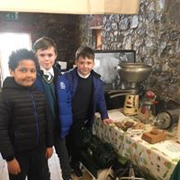
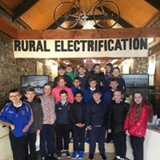
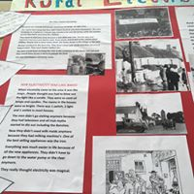
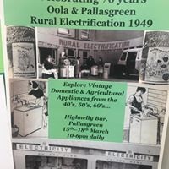
Engineering
Engineers Week 2019
Pupils Showcased their own projects at a local even in the High Nelly Cafe in Pallasgreen. We completed some projects about rural electrification during the 2nd to 8th March and then the following week the pupils displayed and spoke about their findings.

Slide 16
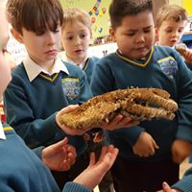
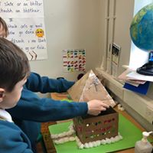
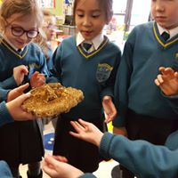
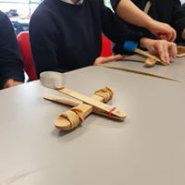
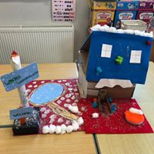
Engineering
Other Design and Make Activities completed.
Investing how & why bees create their hives in hexagon shapes.
Catapults
Designing & Creating Gingerbread Houses

Slide 17
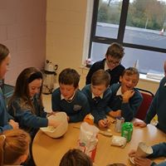
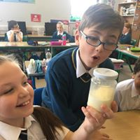
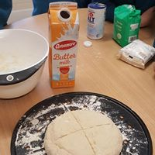
Step 4-MATHS
Baking Homemade Soda Bread
Making Butter
Pupils weighted, measured, cooked and finally created their own lunch!

Slide 18
Pupils weighted, measured, cooked and finally created their own lunch!
YUMMY!

Slide 19
Trip to Joe’s Garden Centre
Pupils went on a fantastic field trip during our plants unit for Aistear. We learnt so much about plants, seeds, and conditions for growing good crops.

